Slide 1
FIT1047 Week 4 Forum
Introduction to Computer Systems, Networks and Security

Slide 2
Learning Outcomes
At the end of this workshop, you will be able to:
1. Understand the layout of computer main memory
2. Understand indirect addressing
3. Be able to write simple assembly code programs that use indirect addressing and subroutines

Slide 3
Forum Activity
Activity 1: Discussion on main memory
Activity 2: Explanation of indirect addressing
Activity 3: Demo on subroutine programming

Slide 4
Activity 1: Memory Organization
Think of it as a sequence of “boxes”:
...
1004
3005
2006
7000
008E
0D80
0000
Each box contains a value (here: a 16-bit number).
This could be a machine code instruction, or data.
We give each box an address: the number of the box, starting from 0.
Programs can read and change the value stored at a location.
000
001
002
003
004
005
006

Slide 5
Activity 1: Addressing Memory
Assuming that one memory chip is addressed as 2K x 8 byte addressable, a memory contains multiple chips that builds a 4 x 2K x 8 addressable memory module, answer the following questions?
How many chips required for 4 x 2K x 8 byte addressable memory?
How many memory locations does this memory has?
How many bits required to address one memory location?
What is the memory size?

Slide 6
Activity 1: Addressing Memory
Assuming that one memory chip is addressed as 2K x 8 byte addressable, a memory contains multiple chips that builds a 16 x 2K x 8 addressable memory module, answer the following questions?
How many chips required for 16 x 2K x 8 byte addressable memory?
How many memory locations does this memory has?
How many bits required to address one memory location?
What is the memory size?
Sample answers will be provided in the Moodle forum on Friday.

Slide 7
Activity 1: Addressing Memory
Assuming that one memory chip is addressed as 2K x 8 byte addressable, a memory contains multiple chips that builds a 4 x 2K x 16 word addressable memory module, answer the following questions?
How many chips required for 4 x 2K x 16 word addressable memory?
How many memory locations does this memory has?
How many bits required to address one memory location?
What is the memory size?

Slide 8
Activity 1: Addressing Memory
Assuming that one memory chip is addressed as 2K x 8 byte addressable, a memory contains multiple chips that builds a 16 x 2K x 16 word addressable memory module, answer the following questions?
How many chips required for 16 x 2K x 16 word addressable memory?
How many memory locations does this memory has?
How many bits required to address one memory location?
What is the memory size?
Sample answers will be provided in the Moodle forum on Friday.

Slide 9
Activity 2: MARIE – Indirect Addressing → LoadI, AddI, StoreI, JumpI
...
...
Example:
1004
3005
0206
7000
008E
0D80
0EA3
200
201
202
203
204
205
206
Load 202: Load value from address 202 into AC. Result: AC=0206.
LoadI 202: Look up value stored at address 202. Value is 0206. Then load value from that address into AC. Result: AC=0EA3.
What is ADR?
myNameAdd, ADR myName
myName, HEX 04A //J

Slide 10
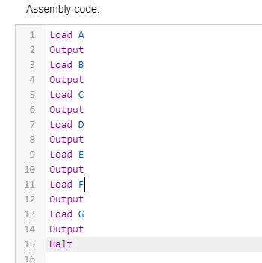
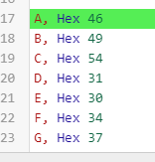
Marie Programming
Using MARIE.js, write a program to output “FIT1047”

Slide 11
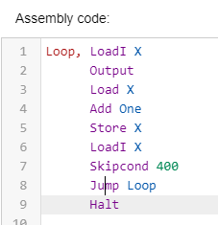
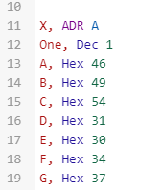
Activity 2: MARIE – Indirect Addressing
Using MARIE.js, write a program to output “FIT1047”. Using LoadI, rewrite the following MARIE code.
Notes:
Load A
Output
Load B
Output
Load C
Output
Load D
Output
Load E
Output
Load F
Output
Load G
Output
Halt
A, Hex 46
B, Hex 49
C, Hex 54
D, Hex 31
E, Hex 30
F, Hex 34
G, Hex 37

Slide 12
Activity 2: MARIE – Indirect Addressing
Using MARIE.js, write a program to add all the values hardcoded in the memory locations. The values are 1, 2, 4, 8, 16, 32, 64. Store the value at the address HEX 030.

Slide 13
Activity 3: MARIE – Subroutine → JnS, JumpI

Slide 14
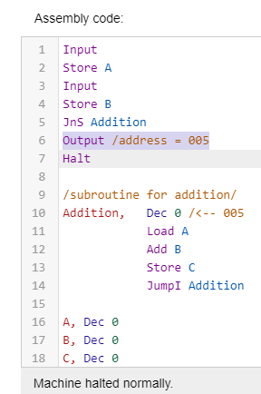
Activity 3: MARIE – Subroutine → JnS, JumpI

Slide 15
Activity 3: MARIE – Subroutine → JnS, JumpI
Write a MARIE program that allows user to enter three inputs, the first two are decimal values (X and Y) for addition (X + Y) and subtraction (X – Y) operations while the third input is a character either “a” or “s” will select the output of addition and subtraction of the two values. Use subroutines to create the addition and subtraction operations.

Slide 16


